Slide 1


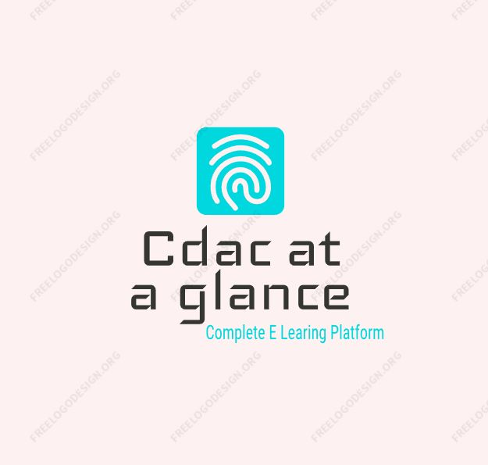
Learn Connect Succed
CDAC at a Glance
BATCH : SEP 2022
GROUP NUMBER : 05 (PG-DAC)
GUIDE NAME : Mr. Pankaj Kumar Mahto
GROUP MEMBERS PRN
1) Bhawana Tiwari (220910120010)
2) Aman Jain (220910120003)
3) Eqtedar Afzal (220910120023)
4) Tarun Namdev (220910120052)

Slide 2
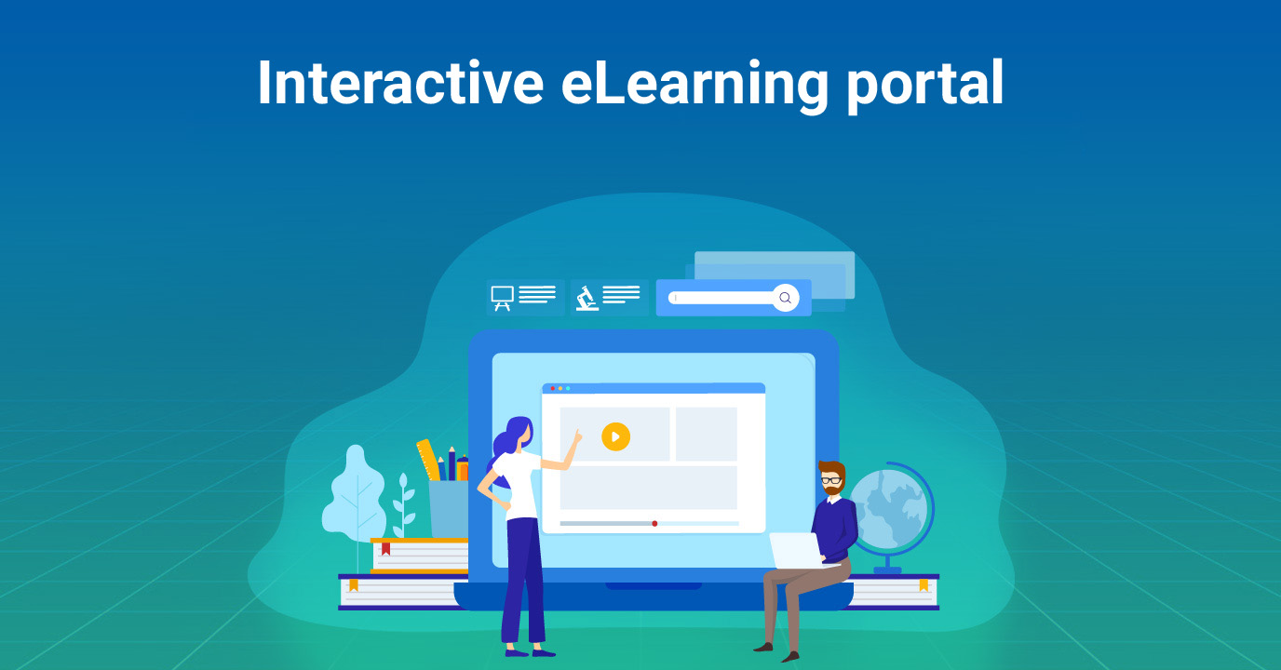
CDAC AT A GLANCE

Slide 3
ABSTRACT
CDAC AT A GLANCE is a centralized website which aims in developing a e-learning platform to access all study related data at a single platform which is required for their pg-diploma course. This website includes various features getting all the contents regarding course ,download feature is also available so as student can collect data at one place.
Faculty will be able to provide course regarding information over here.It lessens the work of faculties as well as better way for students to get updated . To eliminate the manual system, this website has been developed which will handle all the current issues faced by the students. It has a facility for admin login through which the admin can monitor the whole system. It has a facility where students after logging in to their accounts can see the syllabus regarding contents issued .Overall, this project of ours is being developed to help the faculty of the organisation and the students pursuing the course.

Slide 4
OBJECTIVE
To provide a platform for Students to get familiar to the DAC modules.
To facilitate the students to access the Data related to the DAC module. A platform for entire DAC module.
A platform for everything and everything on platform.
To provide a user-friendly and accessible interface for both Faculty and Students.
The ultimate objective is to help Students of the CDAC New Delhi by providing proper study material and guidance for a successful career in IT field.

Slide 5
MODULES
CDAC at a Glance is an online platform designed to facilitate learning through the use of digital technologies. The proposed system of an e-learning platform should include the following components:
User Interface: The user interface should be intuitive and easy to use. The platform should be designed to accommodate users with varying levels of technical expertise.
Content Management: The e-learning platform should have a content management system that allows for the easy creation, uploading, and management of various types of content. This could include video lectures, text-based materials, and assignments.
User Management: The system should have a user management system that allows for easy registration, login, and authentication. It should also provide tools for user profiling, course enrollment, and progress tracking.

Slide 6
PROPOSED SYSTEM
User Experience: The website's interface is intuitive and easy to navigate. Student can easily sign up and log in to their accounts. The student can access the website for module wise learning. And get all the study related notes and videos links.
Functionality: This website allow the students to get all the information’s related to the modules and study material , and they can also download the notes and in future they can able to upload their assignment directly in the website. This website also provide video lecture links.
Performance: The website's performance is consistent, with fast loading times and no noticeable downtime. The website is optimized for all screen sizes, making it accessible to users on desktop and mobile devices. And easy to access.

Slide 7
SCOPE
The main Scope of this project is to create a user-friendly and secure platform for DAC students, a centralized website which aims in developing a e-learning platform to access all study related data at a single platform which is required for their pg-diploma course.
This website includes various features getting all the contents regarding course ,download feature is also available so as student can collect data at one place.
Overall, the aim of the CDAC at a Glance application is to provide a reliable, secure, and efficient platform that connects Students and Faculty on a same platform , and to provide all the study related data to the students for the PG-Dac modules so that they and enhance their skills and knowledge.

Slide 8
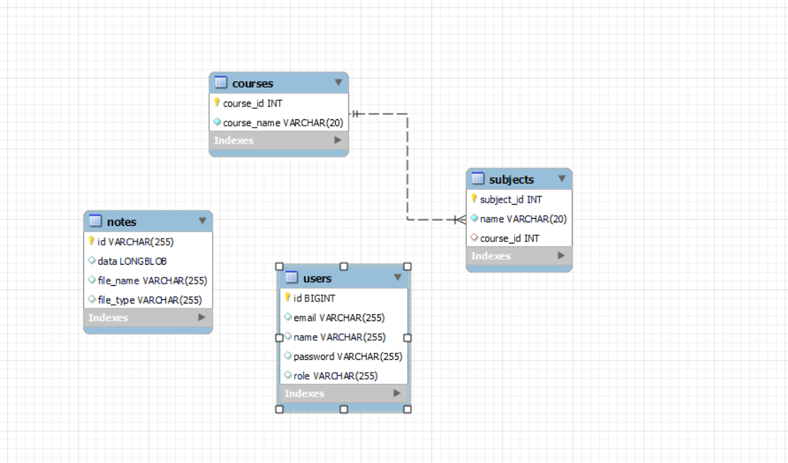
ER DIAGRAM

Slide 9
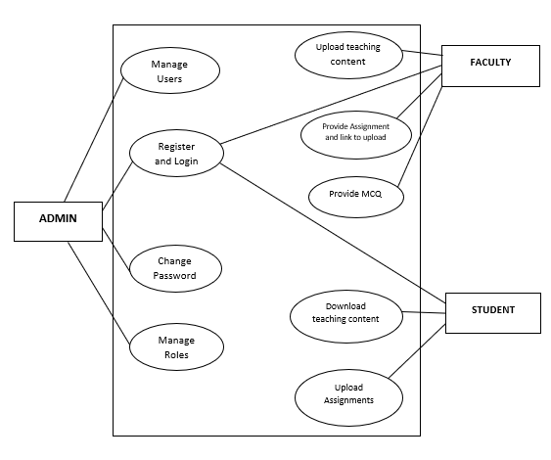
FLOW CHART

Slide 10
TECHNOLOGY used :
Front-End: React Js, HTML5, CSS3, Bootstrap4-5,ReactStrap, JavaScript and React libraries.
Back-End: Spring Boot, Hibernate
Database: MYSQL Workbench

Slide 11
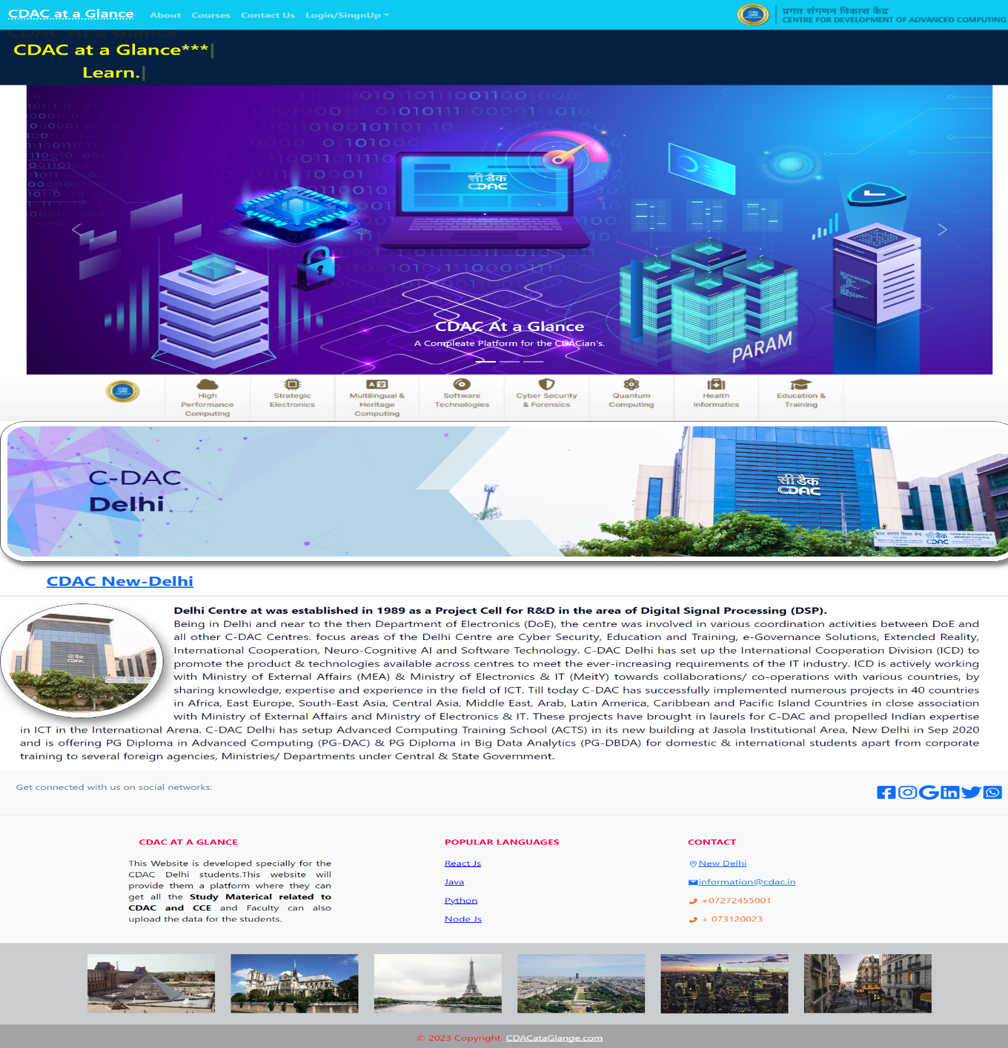
Home page:-
User Interface
Design(GUI):

Slide 12
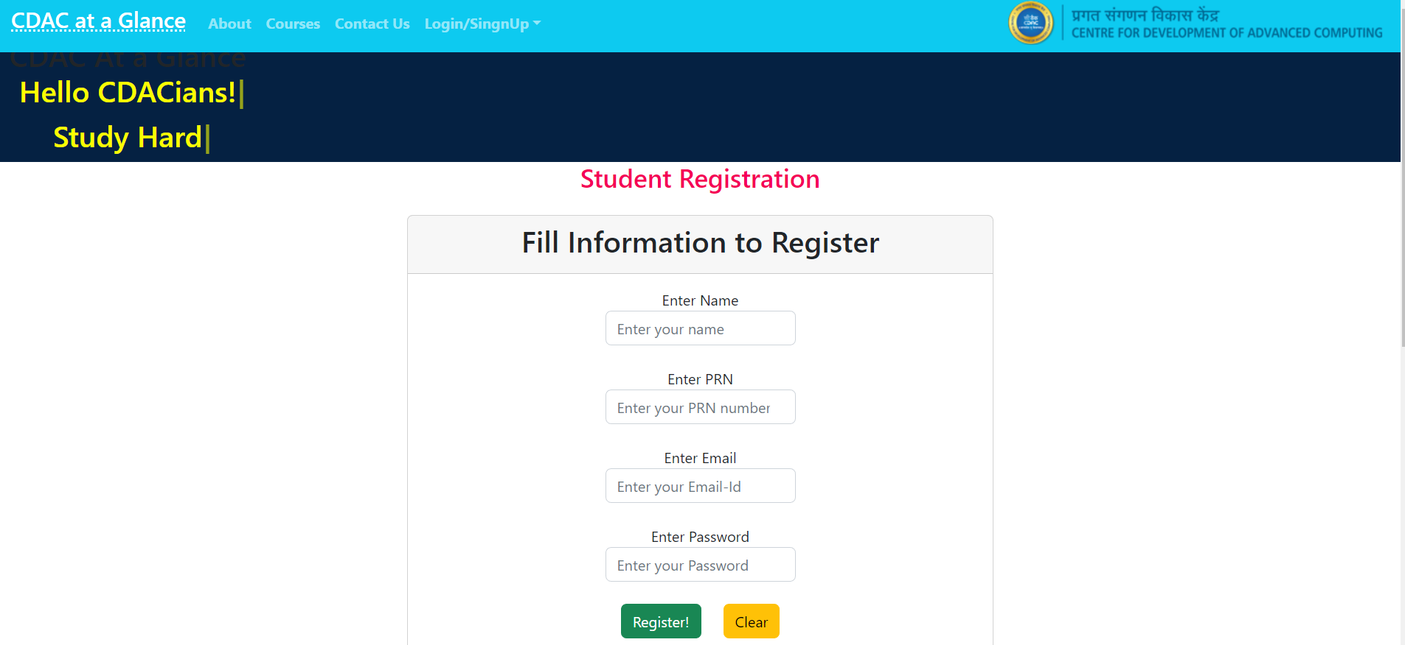
Registration/SingUP for Student's:

Slide 13
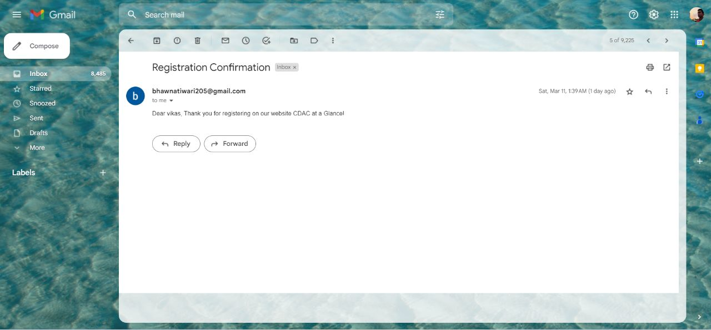
After successful registration:

Slide 14
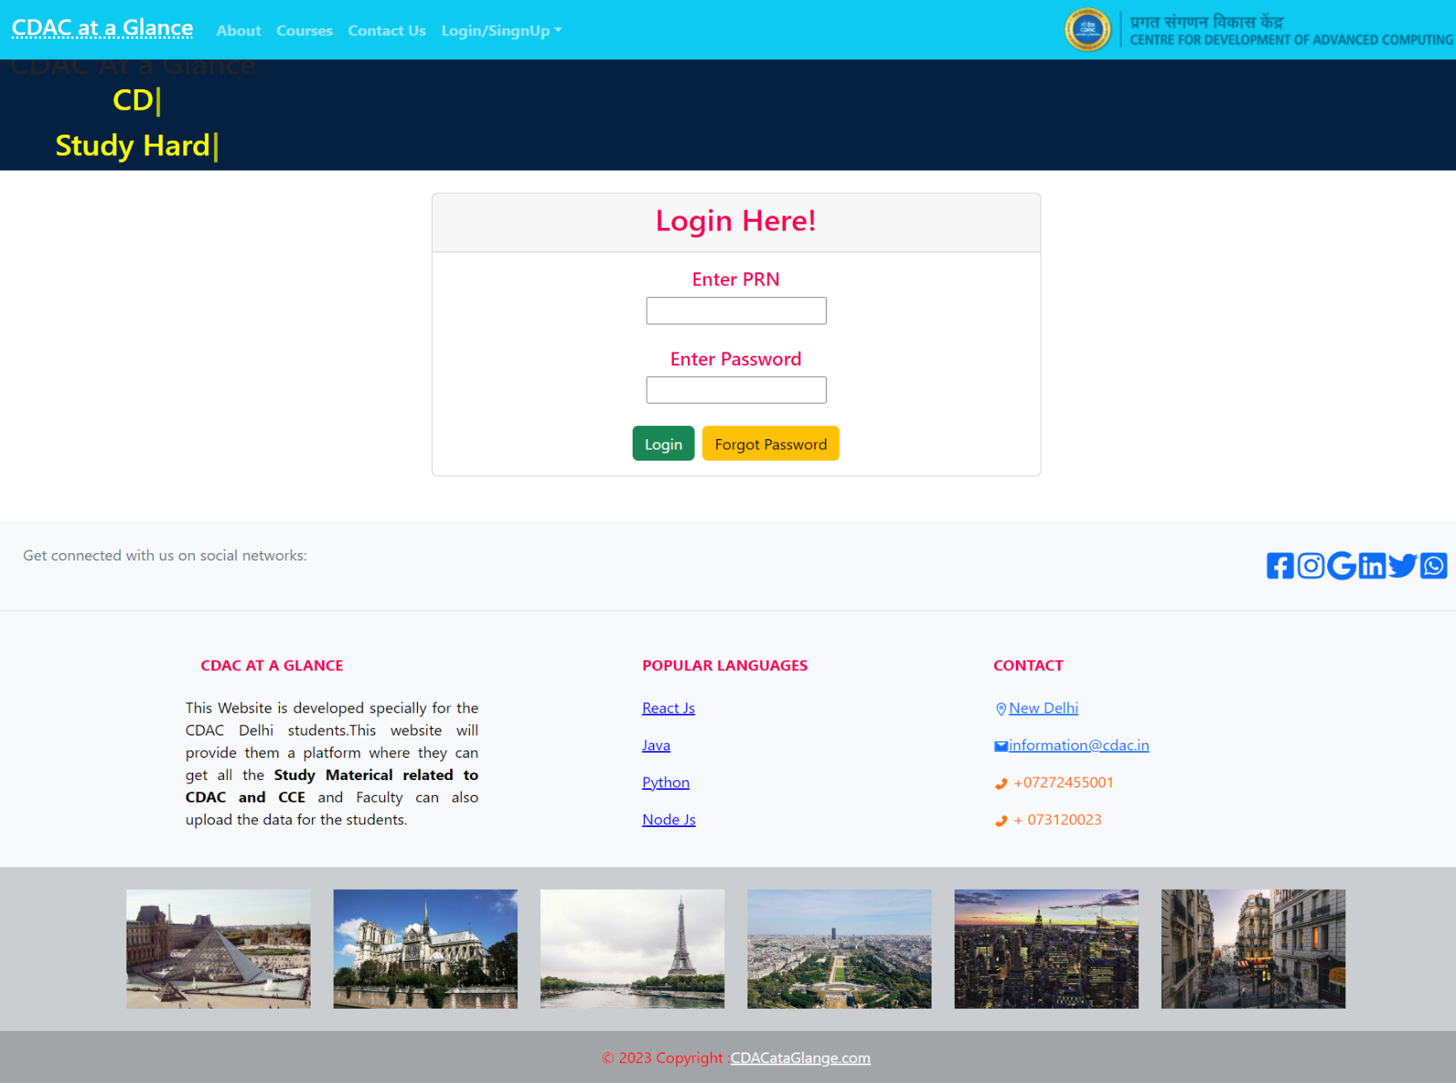
Student Login Page:

Slide 15
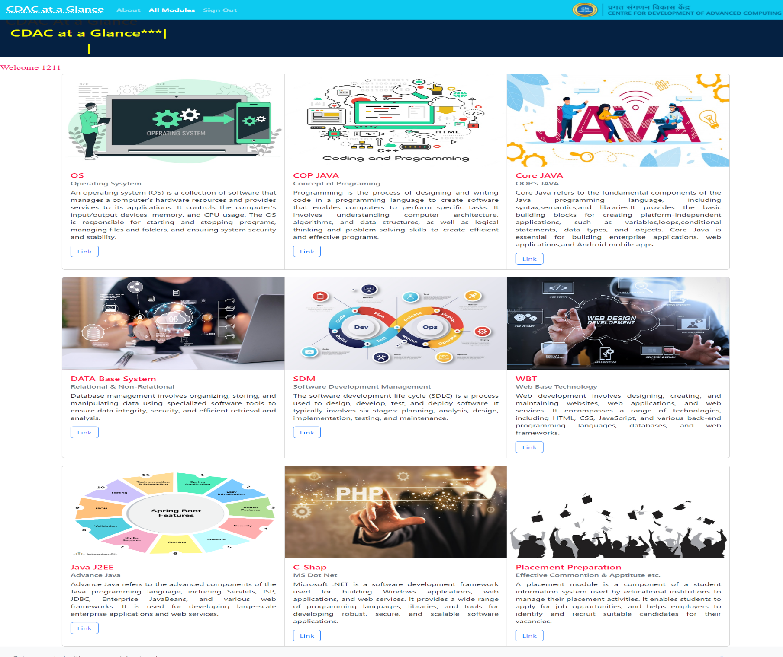
MAIN
PAGE :

Slide 16
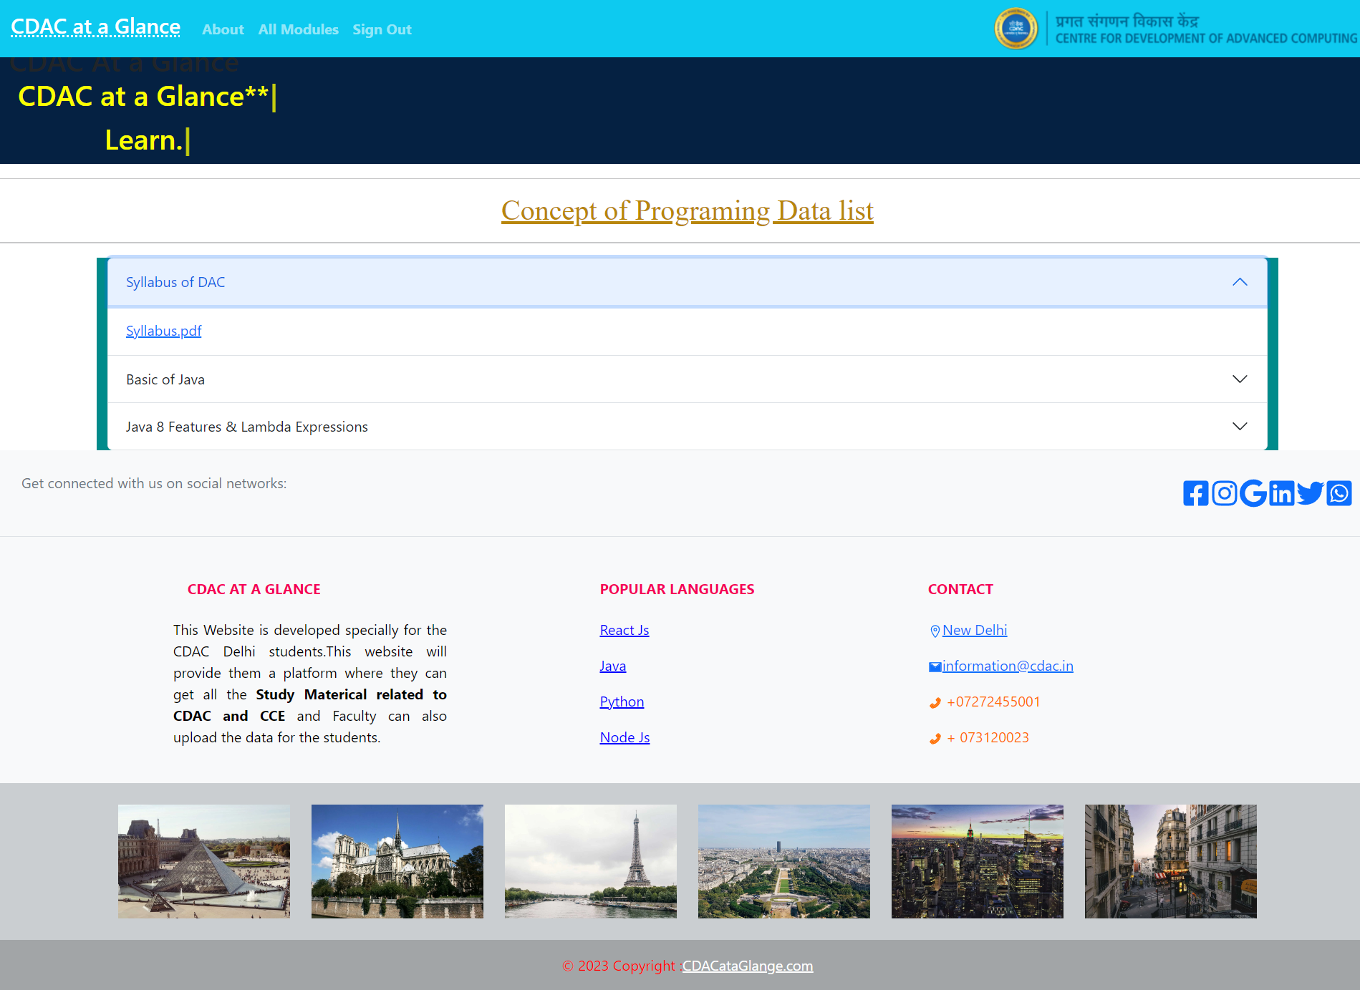
Modules wise download

Slide 17
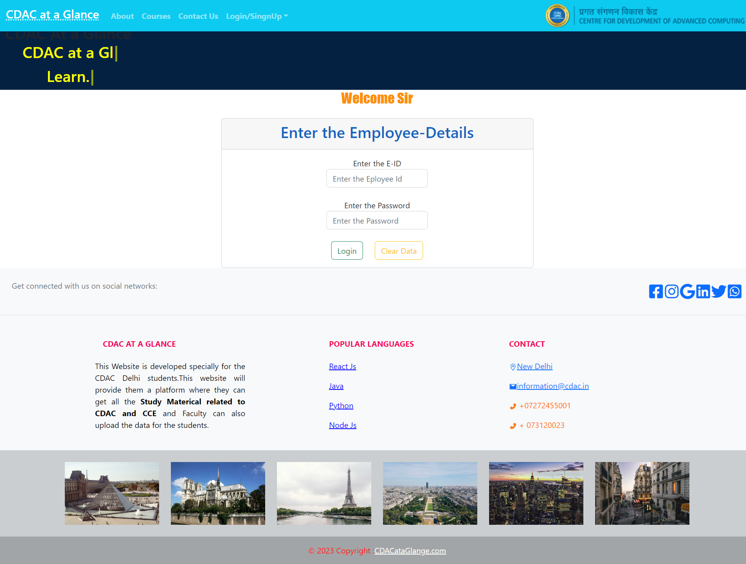
Faculty Login:

Slide 18
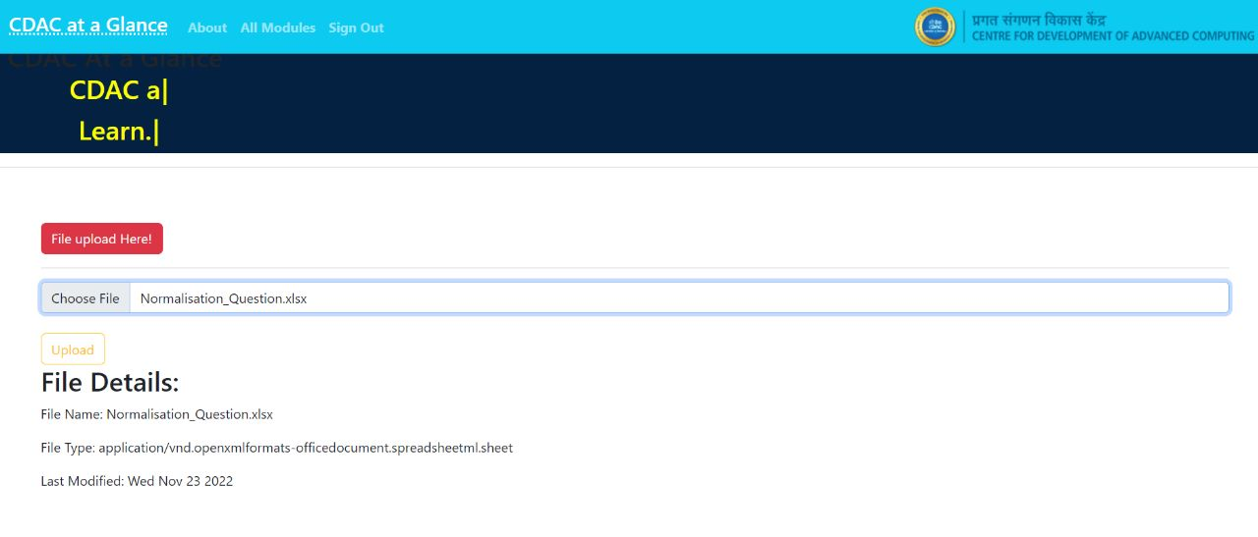
Document Upload :

Slide 19
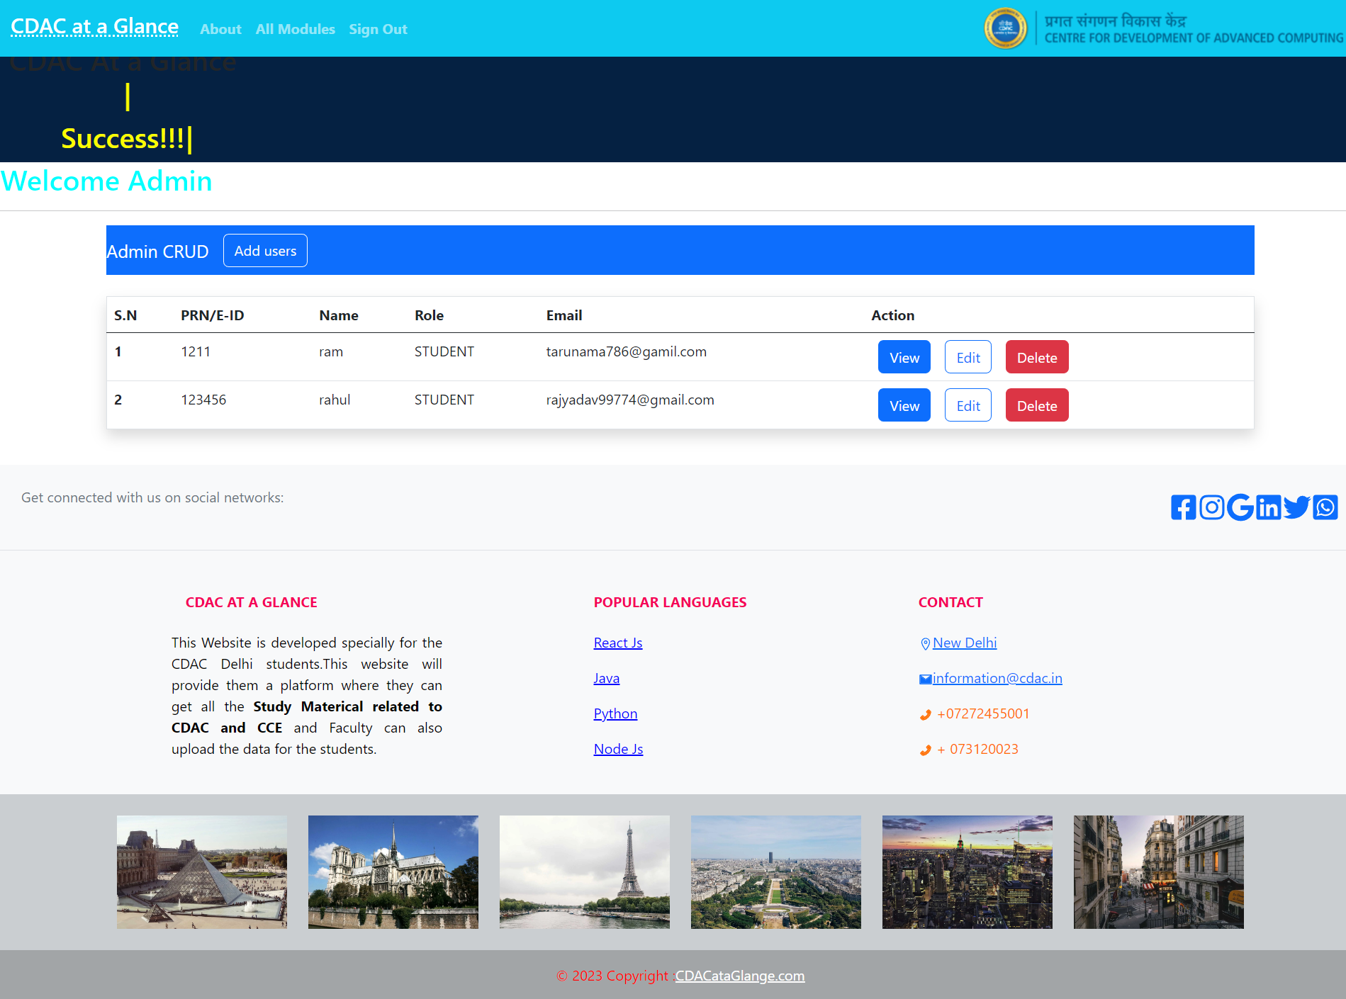
Admin page :

Slide 20
CONCLUSION:
In conclusion, e-learning platforms have become an increasingly popular and effective way to facilitate online learning.
They provide a variety of features and functionalities that allow instructors to create and manage courses online, deliver course content in various formats, facilitate discussions and collaboration among students, assess and grade students' work, and provide centralized learning experiences.
E-learning platforms also offer flexibility and convenience for learners, allowing them to access educational materials and participate in learning activities at their own pace and on their own schedule.

Slide 21
THANK YOU !

